Slide 1
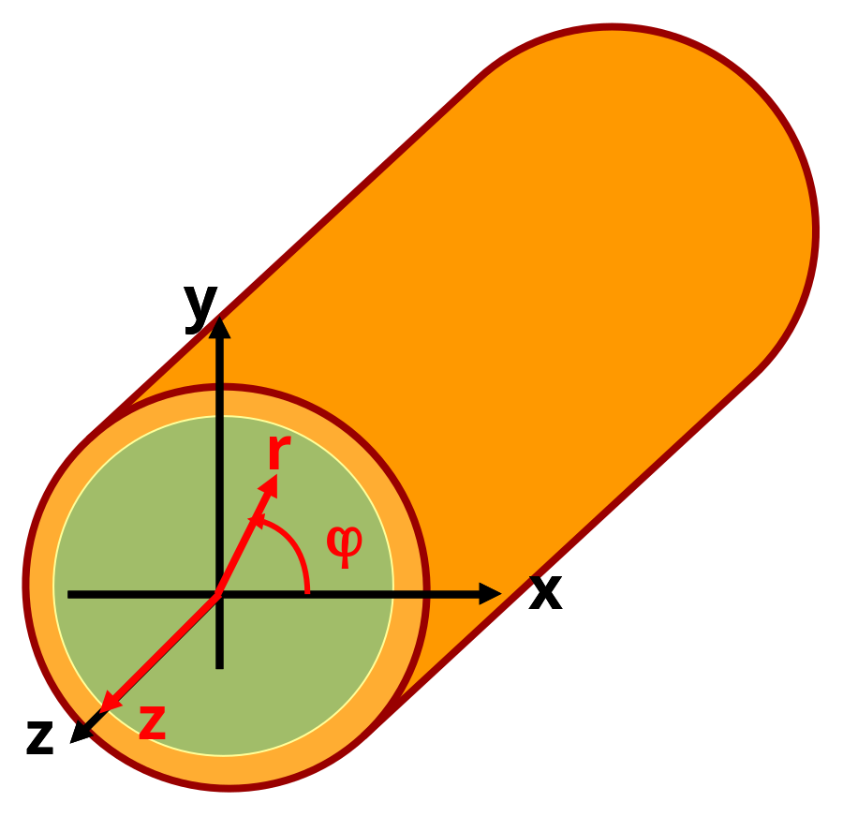
§4.3 Circular waveguide

Slide 2
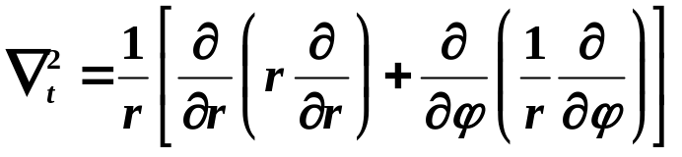
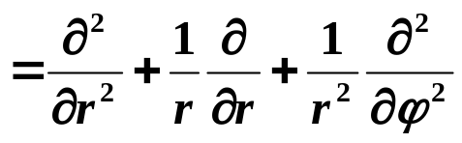
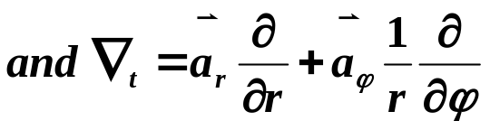
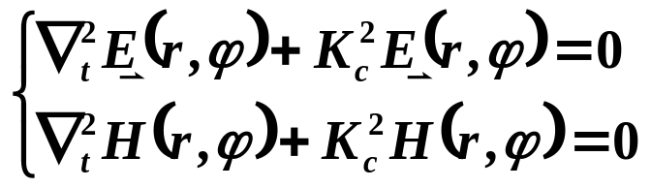
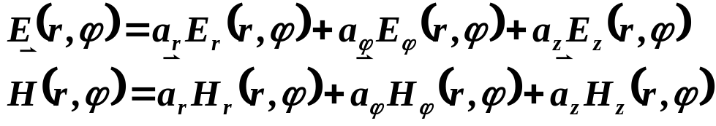
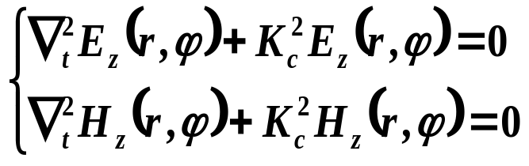
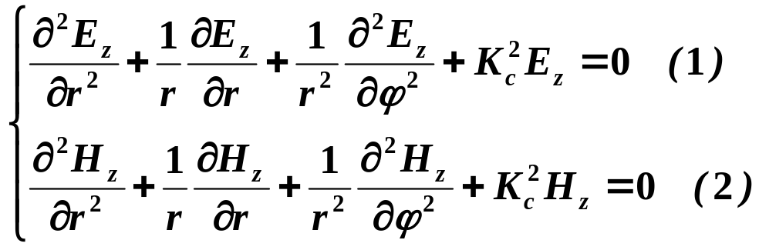
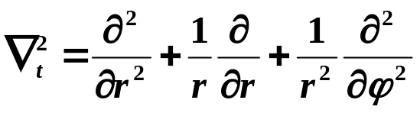
§4.3 Circular waveguide
Employ cylindrical coordinate（r,ϕ,z）

Slide 3
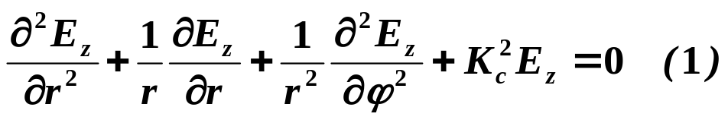
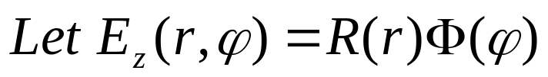
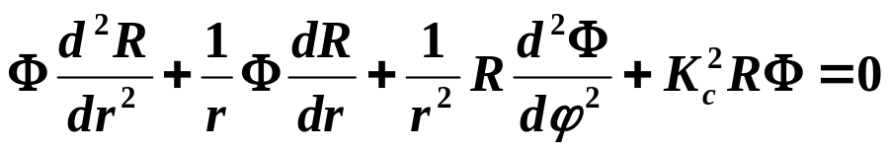
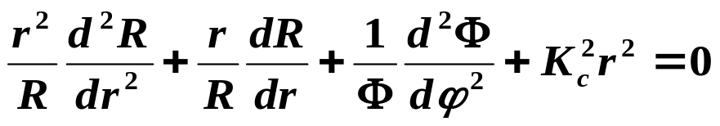
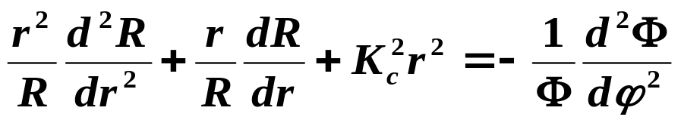
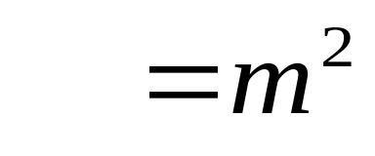
§4.3 Circular waveguide
Substitute into （1）to obtain
Multiplied by r²/RΦ
Depend only on r
Depend only on ϕ

Slide 4
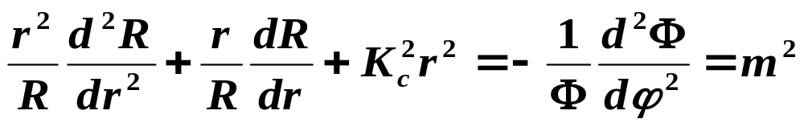
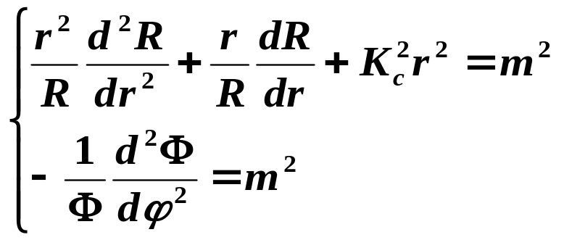
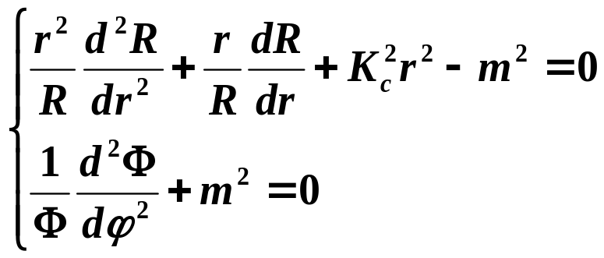
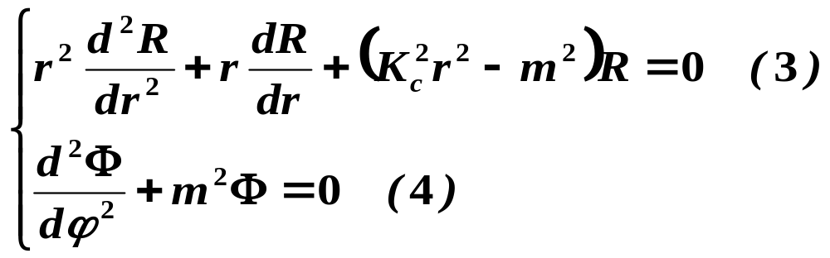
§4.3 Circular waveguide

Slide 5
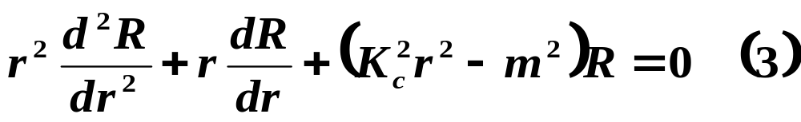
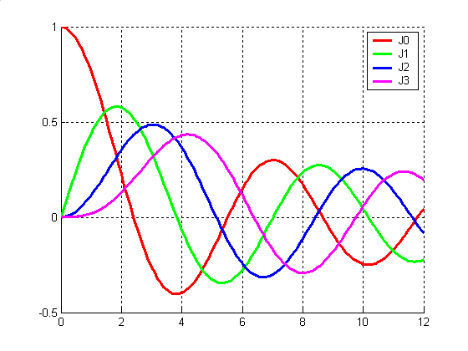
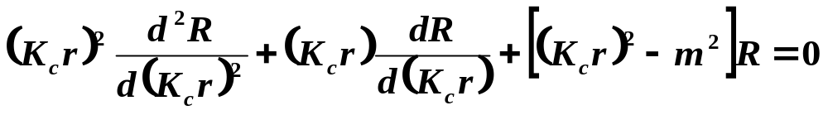
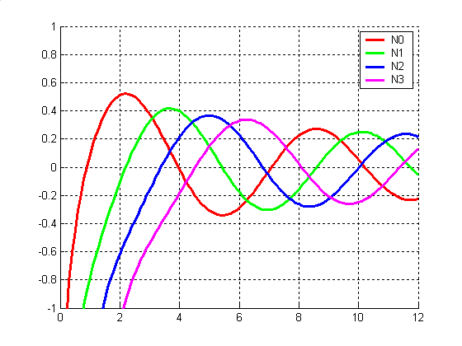
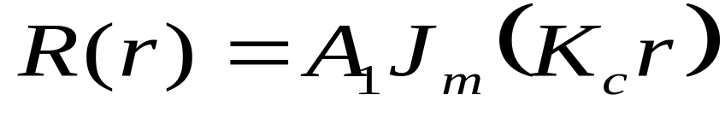
§4.3 Circular waveguide
Bessel’s differential equation
J_{m}（K_{c}r）and N_{m}（K_{c}r）are the Bessel functions of first and second kinds, respectively
When r → 0 ， N_{m}(K_{c}r) → ∞
It is physically unacceptable for the waveguide problem, so A2=0

Slide 6
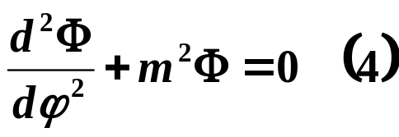

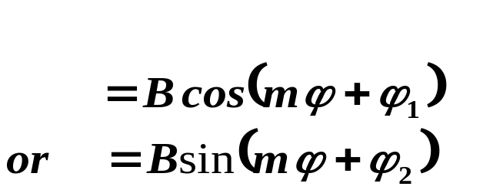
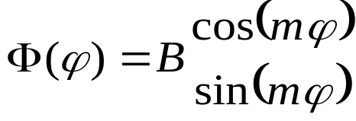
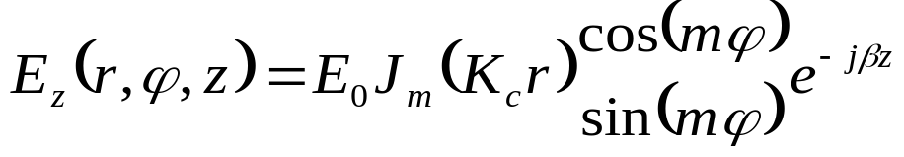
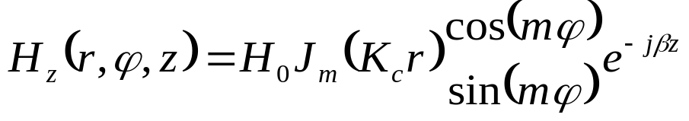
§4.3 Circular waveguide
General solution：
Since the solution must be periodic in ϕ ，
Φ(ϕ +2π)=Φ(ϕ）
→ cos(mϕ)= cos[m(ϕ +2π)]=cos(mϕ +2mπ)
So m must be an integer, m=0,1,2,…
J_{m}（K_{c}r）is Bessel function

Slide 7

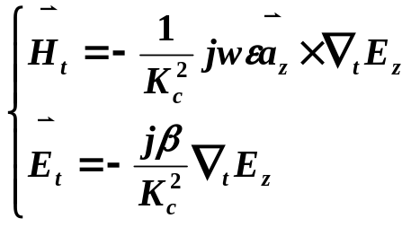
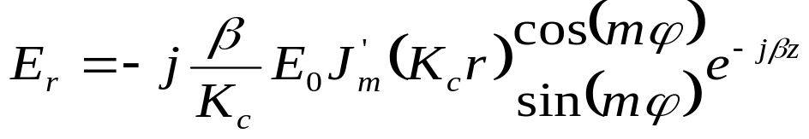
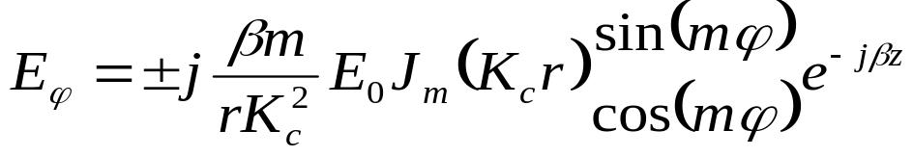
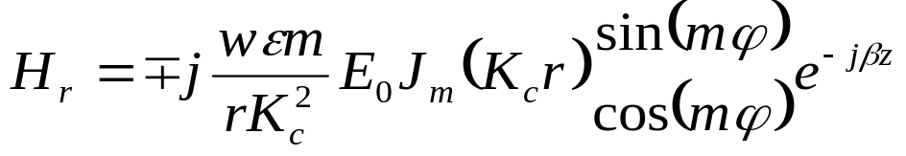
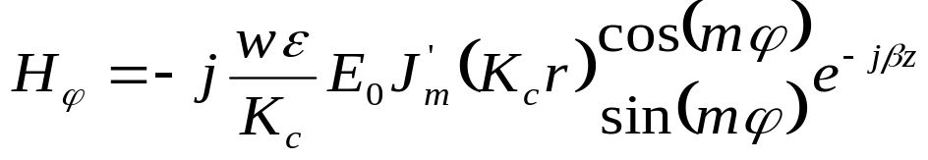
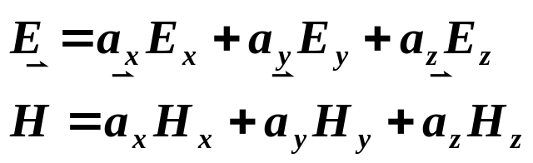
§4.3 Circular waveguide
1. TM mode
J_{m}（K_{c}r）is Bessel function
a) Total fields：

Slide 8
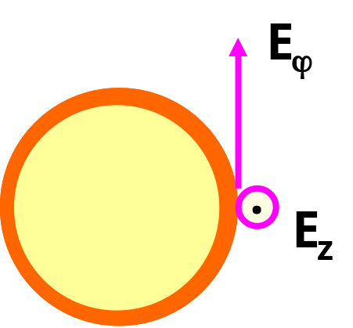
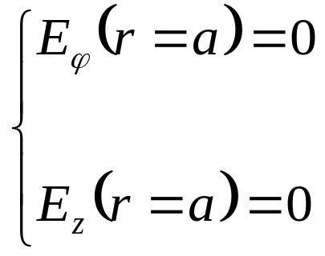
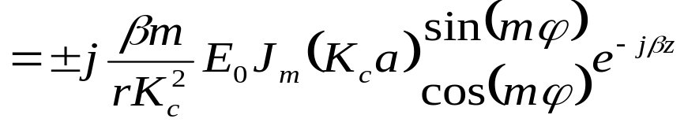
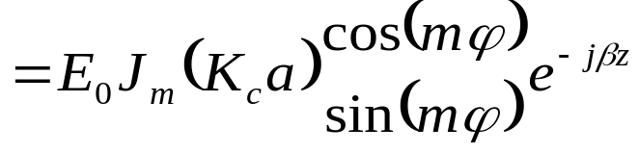
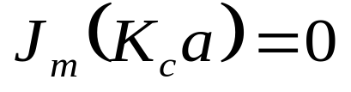
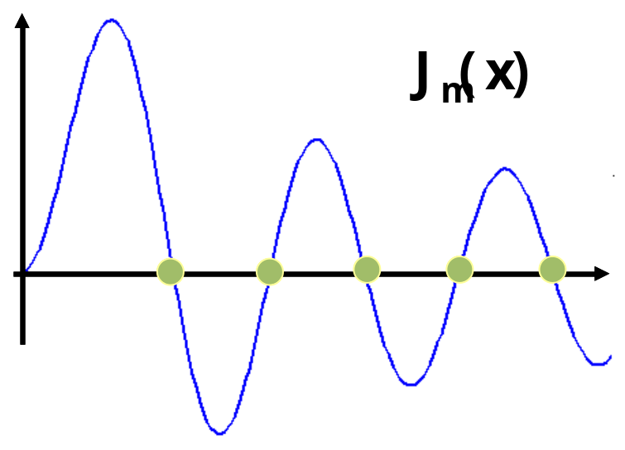
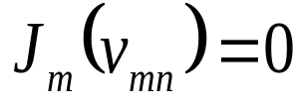
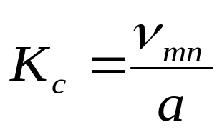
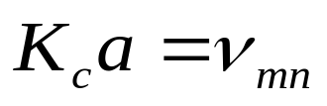
§4.3 Circular waveguide
b) Kc
Determine the cutoff wavenumber by enforcing the boundary condition on the waveguide wall
V_{mn} is the nth root of Jm(x)
m＝0,1,2,… n=1,2,3,…

Slide 9
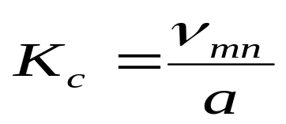
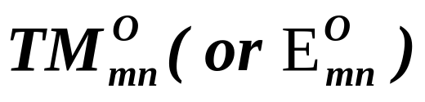
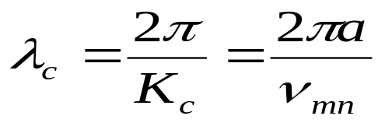
§4.3 Circular waveguide
c) m,n
m=0,1,2,…;n=1,2,3,…
m refers to the number of circumferential (φ) variation
n refers to the number of radial variations
K_{c}r
m n | 1 | 2 | 3 | 4
0 | 2.405 | 5.520 | 8.654 | 11.792
1 | 3.832 | 7.016 | 10.173 | 13.324
2 | 5.136 | 8.417 | 11.620 | 14.796
Cutoff wavelength：
Dominant TM mode is TM₀₁

Slide 10


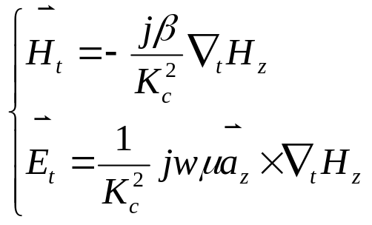
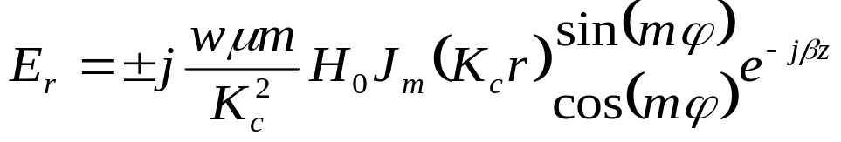
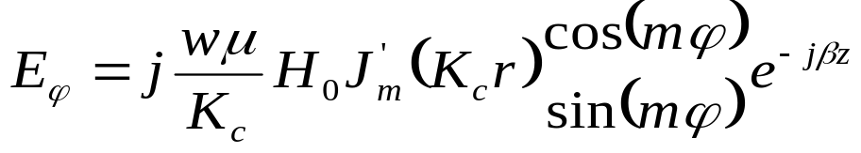



§4.3 Circular waveguide
2. TE mode
a) fields：

Slide 11








§4.3 Circular waveguide
b) Kc
U_{mn} is the nth root of J_{m}’(x)
m＝0,1,2,… n=1,2,3,…

Slide 12



§4.3 Circular waveguide
c) m,n
m=0,1,2,…;n=1,2,3,…
m refers to the number of circumferential (φ) variation
n refers to the number of radial (ρ) variations
K_{c}r
m n | 1 | 2 | 3 | 4
0 | 3.832 | 7.016 | 10.173 | 13.324
1 | 1.841 | 5.332 | 8.536 | 11.706
2 | 3.054 | 6.706 | 9.965 | 13.170
Cutoff wavelength
Dominate TE mode is TE₁₁ mode

Slide 13

§4.3 Circular waveguide

Slide 14


§4.3 Circular waveguide
2. Propagation characteristics
(1) Cutoff wavelength
（1）λc_{TE11}＝3.41a
λc_{TM01}＝2.62a
λc_{TE21}＝2.06a
λc_{TE01}＝λc_{TM11}＝1.64a
TE₁₁is the dominate mode
（2）2.62a<λ<3.41a
only TE₁₁ mode

Slide 15


§4.3 Circular waveguide
(2) Degenerate mode
（a）Degenerate waveguide modes/TE-TM mode degeneracy
since
TE_{0n} and TM_{1n} are E－H mode degenerate
（b） Polarized degenerate modes

Slide 16






§4.3 Circular waveguide
(3) Power flow and the attenuation
The power flow down the guide can be computed as

Slide 17








§4.3 Circular waveguide
( a ) TM_{mn}
When m≠0

Slide 18






§4.3 Circular waveguide

Slide 19






§4.3 Circular waveguide
(b) When m＝0

Slide 20





§4.3 Circular waveguide
(b) TE
m≠0时

Slide 21




§4.3 Circular waveguide
m=0 (TE_{0n})

Slide 22

§4.3 Circular waveguide
Attenuation of various modes in a circular copper waveguide with a = 2.54 cm.

Slide 23




§4.3 Circular waveguide
Example： Characteristics of a circular waveguide
Find the cutoff frequencies of the first two propagating modes of a Teflon-filled circular waveguide with a=0.5. If the interior of the guide is gold plated, calculate the overall loss in dB for a 30cm length operating at 14GHz
Solution:
Only the TE11 mode is propagating at 14GHz

Slide 24



§4.3 Circular waveguide
The conductivity of gold is σ=4.1*10⁷ S/m
The total attenuation is
Then the loss in the 30cm length of guide is

Slide 25

§4.3 Circular waveguide
3. Field lines for some of the lower order modes

